Slide 1


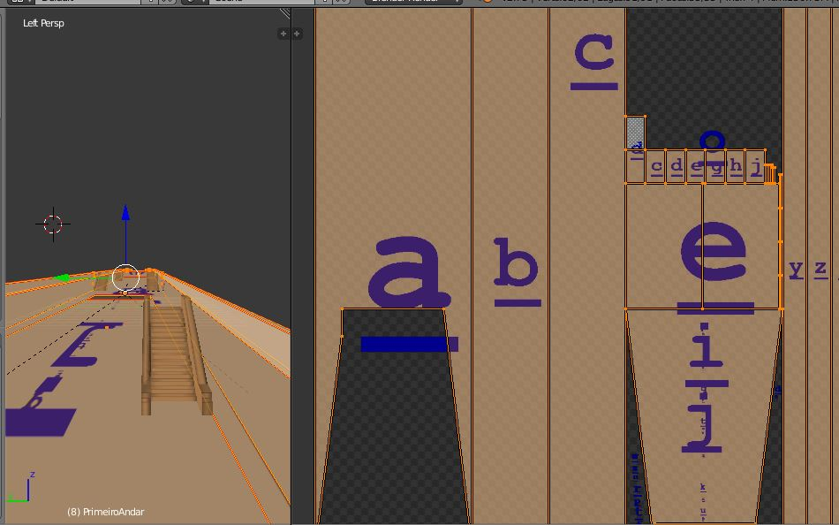
smartTextureMap
Guide – Pass less time organizing texture map identifying its faces!

Slide 2
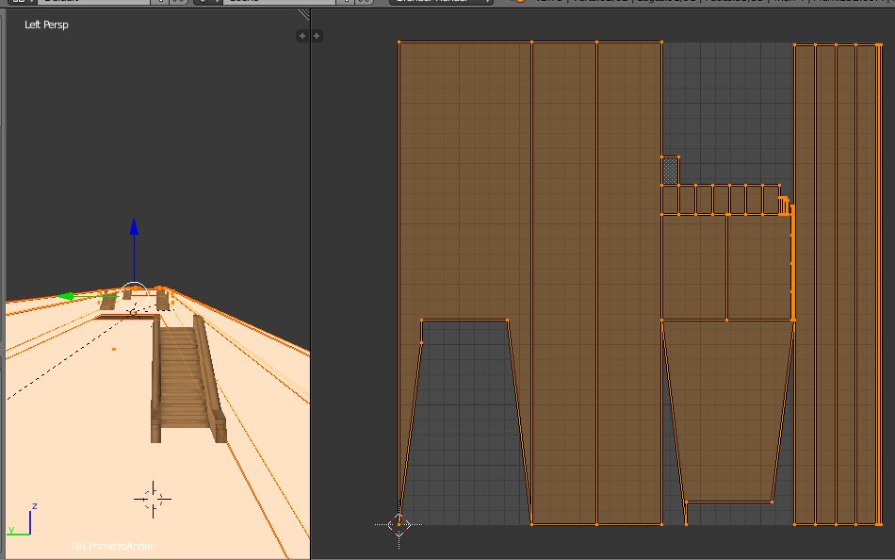
1) Export the texture map in Blender, or in your 3D modeler preferred

Slide 3
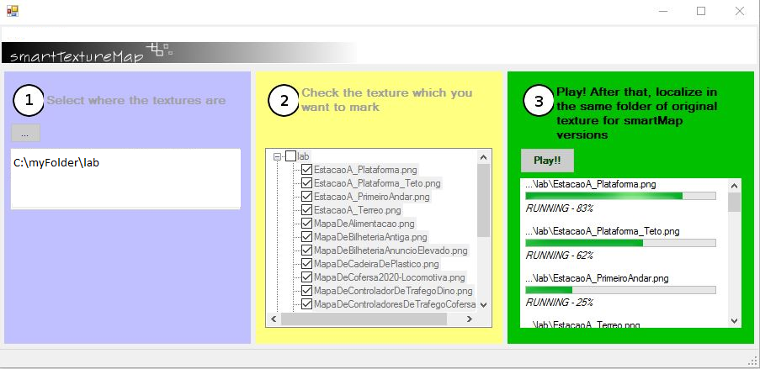
2) Run smartTextureMap. You have two options:
Windows Command Prompt - Uses smartTextureMap from Windows Command Prompt to identify the faces, indicating the full path of file exported. Ex.: smartTextureMap MyTexture.png | Windows 10 – Give a double click from Windows Explorer in smartTextureMap.exe, or from Windows Command Prompt without parameters

Slide 4
3) Reimport the new generated file (<<file>>.smartMap.<<png/bmp>>)

Slide 5
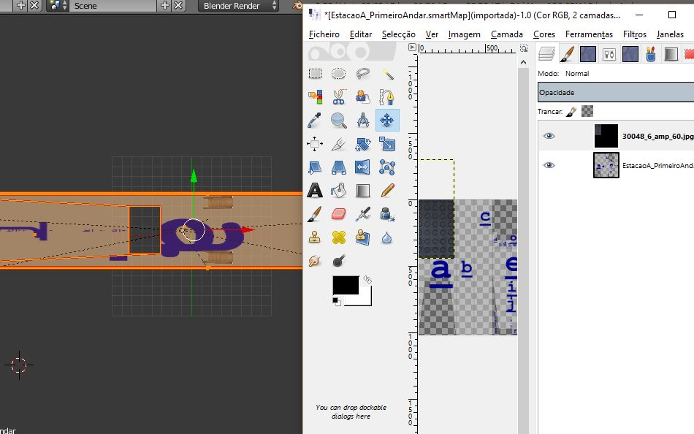
4) Using a photo editor (such as Photoshop or GimpShop), identify the faces. Paste the image above them. If they are upside-down in Blender (check how the letters looks like), rotate the image textures.
(Use layers/canvas to gain versatility)

Slide 6
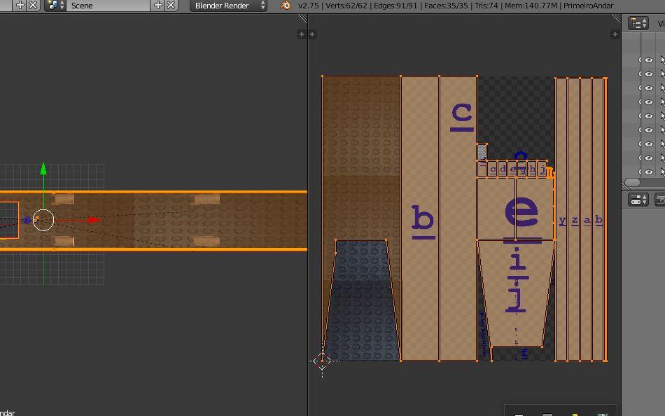
5) Refresh image view in Blender and proceed to the rest of faces

Slide 7
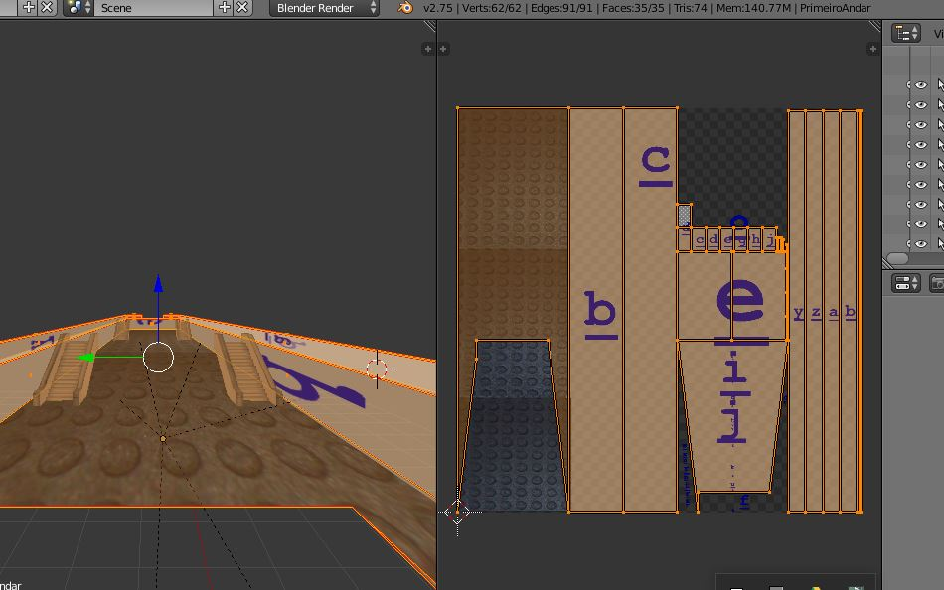
6) It's up to you! Now you need to less travels between Image editor and 3D modeler. You even can avoid to map seams of modelers less important and concentrate in which it's really important.

